Slide 1

Geometry matters: insights from Ollivier Ricci Curvature and Ricci Flow into representational alignment
Nahid Torbati^{1,2}, Michael Gaebler^{1,3}, Simon M. Hofmann^{*1,} Nico Scherf*^{1,2}
¹ Max Planck Institute for Human Cognitive and Brain Sciences, Leipzig, Germany | ² Center for Scalable Data Analytics and Artificial Intelligence (ScaDS.AI), Dresden/Leipzig, Germany |
³ Berlin School of Mind and Brain, Humboldt-Universität zu Berlin, Berlin, Germany

Slide 2
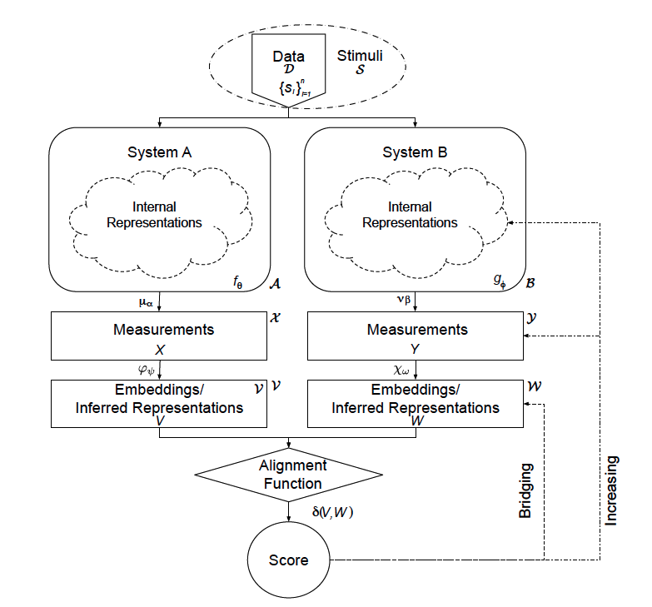

Representational Alignment:
Investigating how biological and artificial neural networks (ANNs) tackle tasks like face recognition and object classification is a key challenge in cognitive science and machine learning.
Central question: Do different systems develop similar internal representations when solving the same computational problems?
Representational alignment studies aim to reveal both the extent of correspondence and the reasons behind similarities or differences across systems.

Slide 3
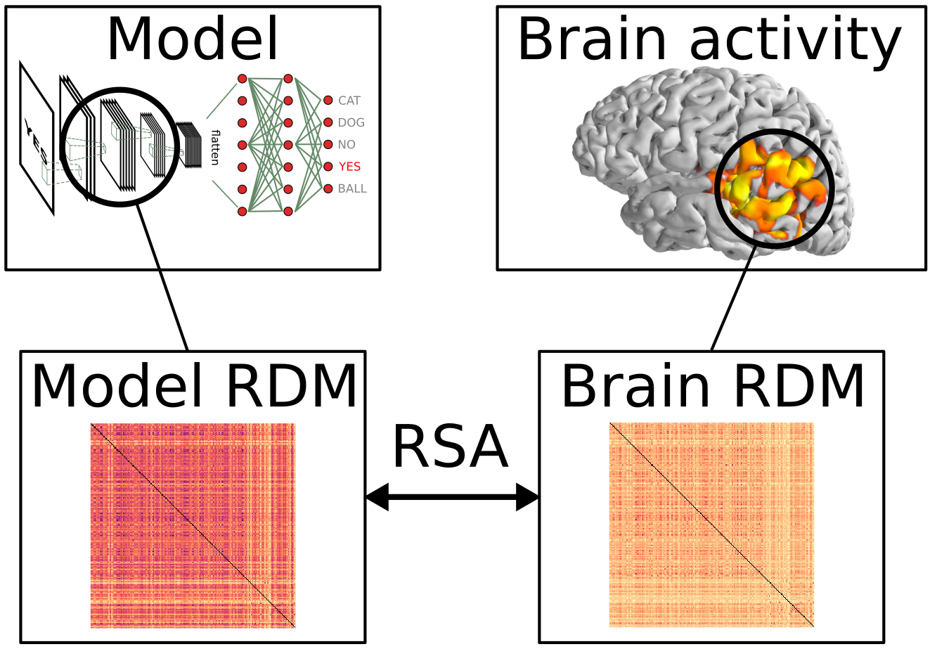
Representational Similarity Analysis (RSA):
Investigating how biological and artificial neural networks (ANNs) tackle tasks like face recognition and object classification is a key challenge in cognitive science and machine learning.
Central question: Do different systems develop similar internal representations when solving the same computational problems?
Representational alignment studies aim to reveal both the extent of correspondence and the reasons behind similarities or differences across systems.
Representational Similarity Analysis (RSA) is a multivariate method for comparing representational structures across modalities, especially between biological and artificial systems.

Slide 4
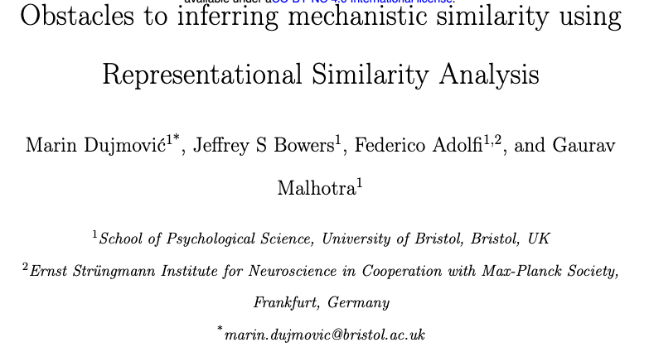
Critical Studies:
Dataset and feature dependencies can inflate similarity, such as between texture-based DNNs and shape-based human vision.

Slide 5
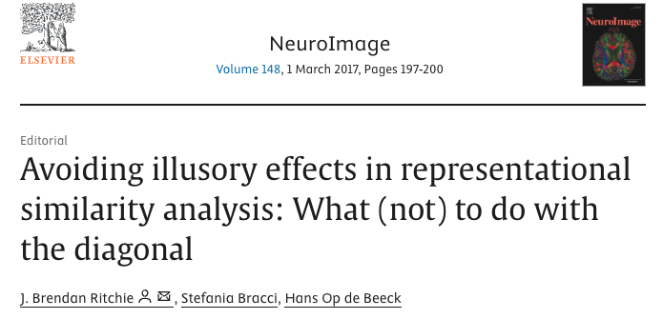
Critical Studies:
Dataset and feature dependencies can inflate similarity, such as between texture-based DNNs and shape-based human vision.
Diagonal entries in RDMs can artificially boost correlations.

Slide 6
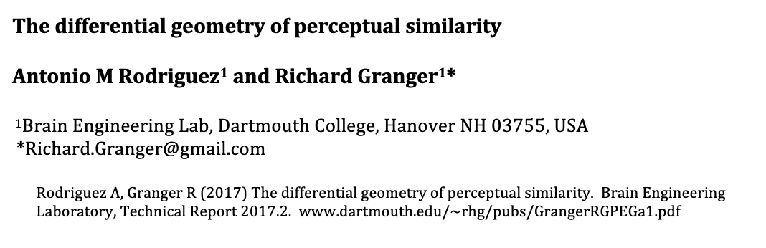
Critical Studies:
Human similarity judgments often deviate from Euclidean assumptions, aligning better with Riemannian geometry.

Slide 7
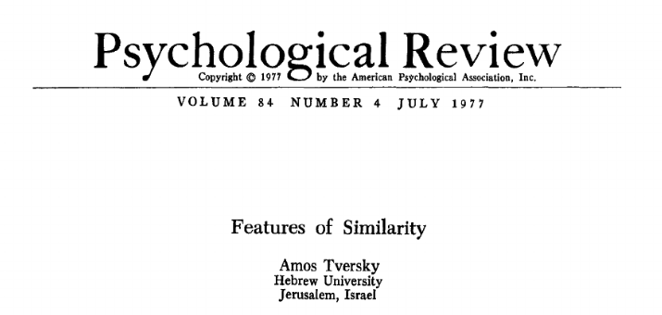
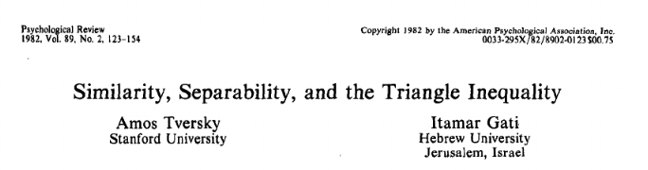
Critical Studies:
Human similarity judgments often deviate from Euclidean assumptions, aligning better with Riemannian geometry.
violating symmetry and triangle inequality constraints.

Slide 8
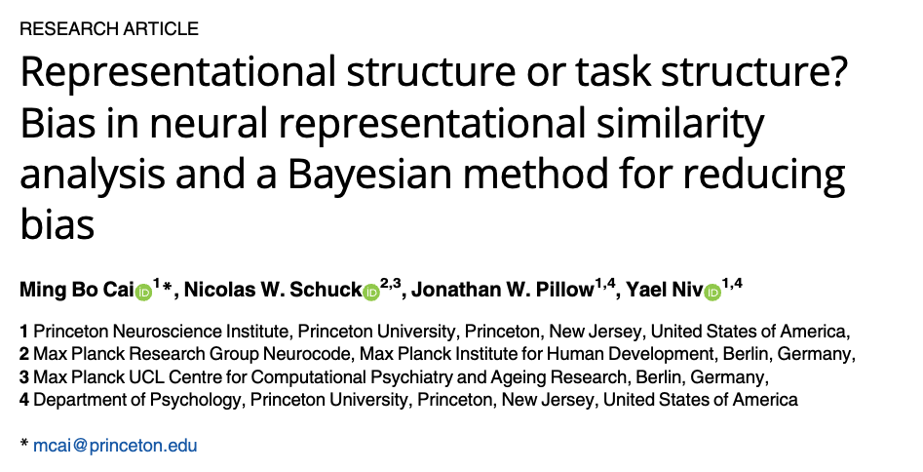
Critical Studies:
Human similarity judgments often deviate from Euclidean assumptions, aligning better with Riemannian geometry.
violating symmetry and triangle inequality constraints.
Estimation biases tied to task design and within-run correlations further undermine standard RSA, motivating Bayesian approaches that model raw data directly.

Slide 9
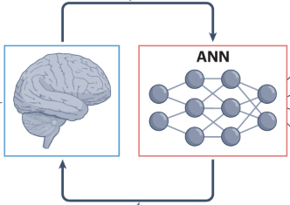
Study Motivation:
Primary Aim:
Comparing human behavior (similarity judgments) with artificial neural network representations.
Employing geometrical methods, Ollivier Ricci Curvature and Ricci Flow
Contribution:
A novel geometry-aware framework
Revealing the limits of behavioral alignment
Identifying alignment deficits to form relevant semantic structures

Slide 11
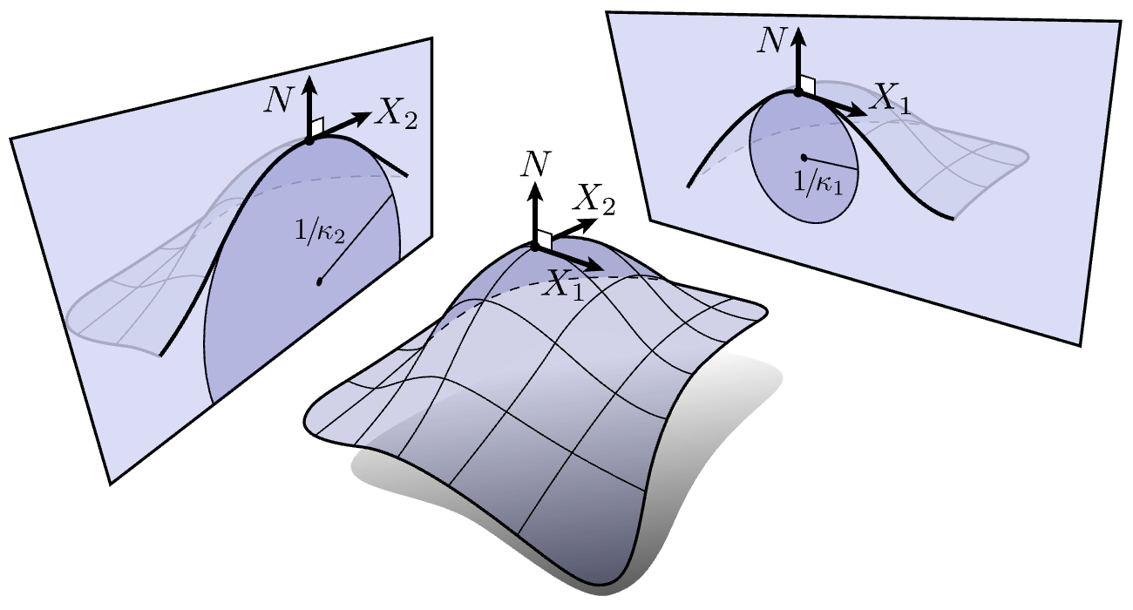
Curvature:
Curvature reveals how much our space (area, neighborhood) deviates from a flat space.
How bent a space is at any point.

Slide 12
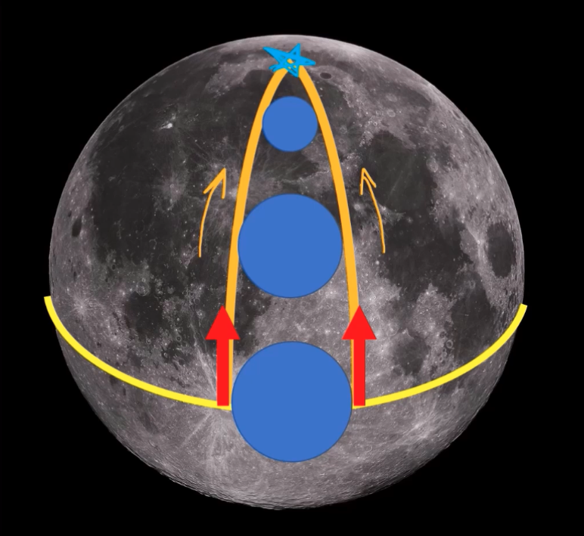
Ricci Curvature:
Two people standing on the moon‘s equator, facing north.
Going straight along the geodesics that point north.
Because of the curvature of the moon, they naturally get closer and closer.
A circle is sitting between them; this circle gets smaller and smaller as each moves further along the geodesics.
The change in the size of the circle illustrates the Ricci curvature
The faster it changes, the higher the curvature

Slide 13
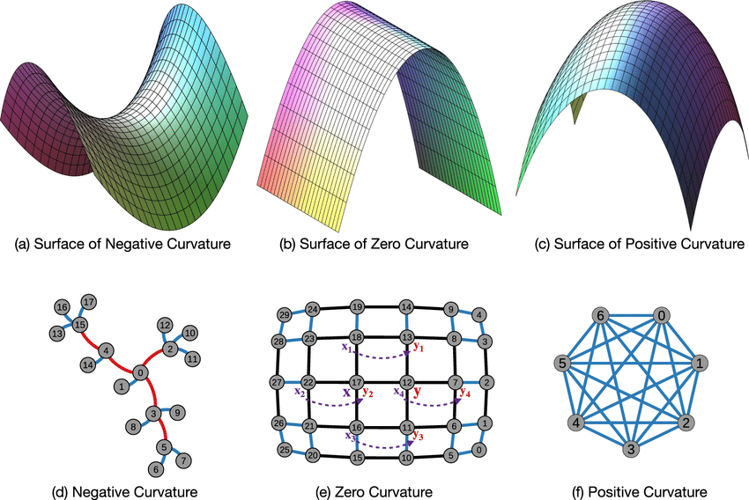
Discrete Ricci Curvature: Ollivier Ricci
a discrete, graph-based analog of Ricci curvature in Riemannian geometry.
It reflects the graph geometry by considering local neighborhoods.
It computes the optimal transport between probability measures at each node.

Slide 14
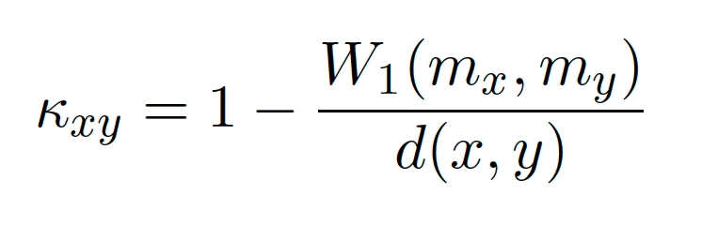
Discrete Ricci Curvature: Ollivier Ricci
An edge property in graphs
It also shows the robustness of the graph against edge removal.

Slide 15
Discrete Ricci Curvature: Ollivier Ricci
Zero curvature
Grid-like topology
Similar to Euclidean geometry in continuous spaces.
A similar pattern of connection across the nodes.

Slide 16
Discrete Ricci Curvature: Ollivier Ricci
Negative curvature
Tree-like (hierarchical)structure
The neighborhoods of the two connected nodes are spreading out
More loosely connected or expansive structure
The information takes longer to spread between nodes

Slide 17
Discrete Ricci Curvature: Ollivier Ricci
Positive curvature
Clique-like structure
The neighborhoods of two connected nodes are highly overlapping.
Well-connected local structure.
Information or influence spreads faster.

Slide 18
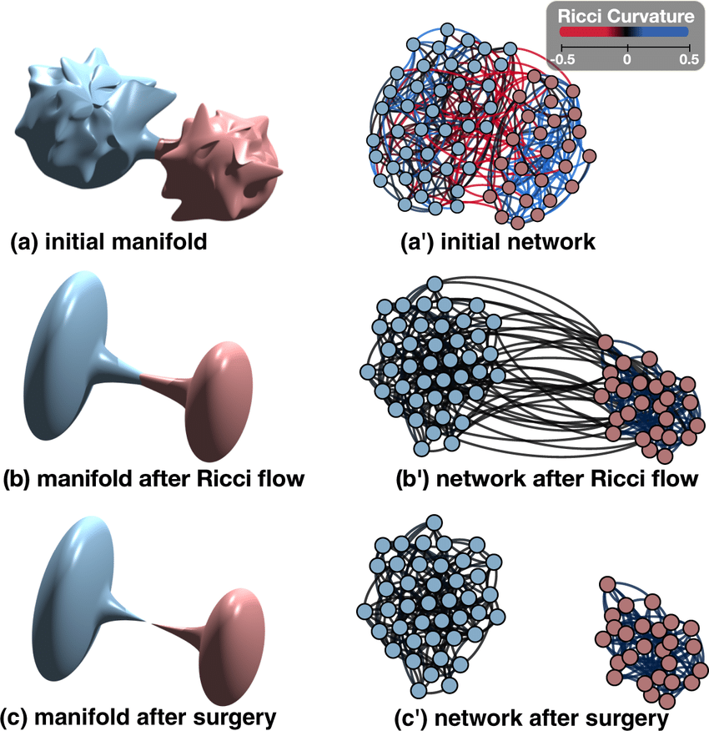
Ricci Flow and Community Detection:
Ricci flow, a curvature-driven diffusion process, deforms space similarly to heat diffusion, describing how space bends at each point.
Areas with high positive curvature are denser, while regions with negative curvature are less dense
regions with large positive curvature contract, while those with strong negative curvature expand

Slide 19
Ricci Flow and Community Detection:
Ricci flow, a curvature-driven diffusion process, deforms space similarly to heat diffusion, describing how space bends at each point.
Areas with high positive curvature are denser, while regions with negative curvature are less dense
regions with large positive curvature contract, while those with strong negative curvature expand.
Flow-Metric: is calculated between nodes using the weighted shortest path, where the edge weights are derived from the final output of the flow process.

Slide 20
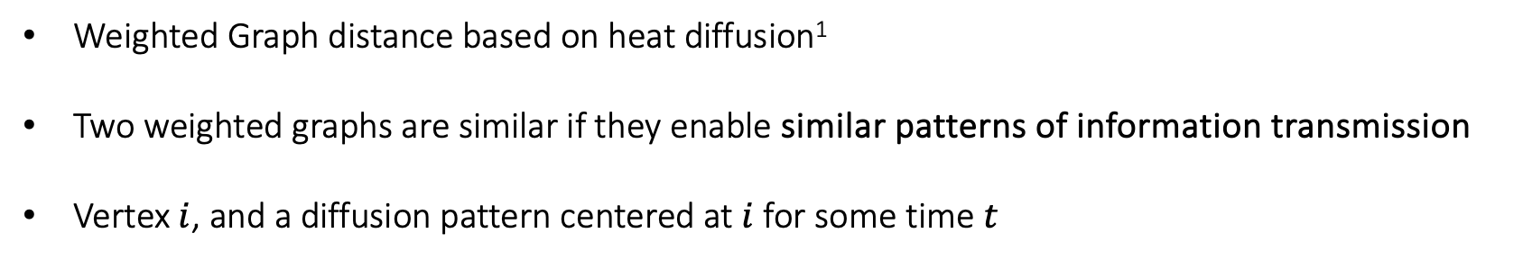
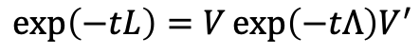
Heat Diffusion Distance:
Weighted Graph distance based on heat diffusion¹
Two weighted graphs are similar if they enable similar patterns of information transmission
Vertex $i$, and a diffusion pattern centered at $i$ for some time $t$
$$D\left(A_{1},A_{2},t\right)= {\left\|\exp\left(−tL_{1}\right)−\exp\left(−tL_{2}\right)\right\|}_{F}^{2}$$
$$\exp\left(−tL\right)=V\exp\left(−tΛ\right)V^{′}$$
1. DK Hammond et al., 2013

Slide 21
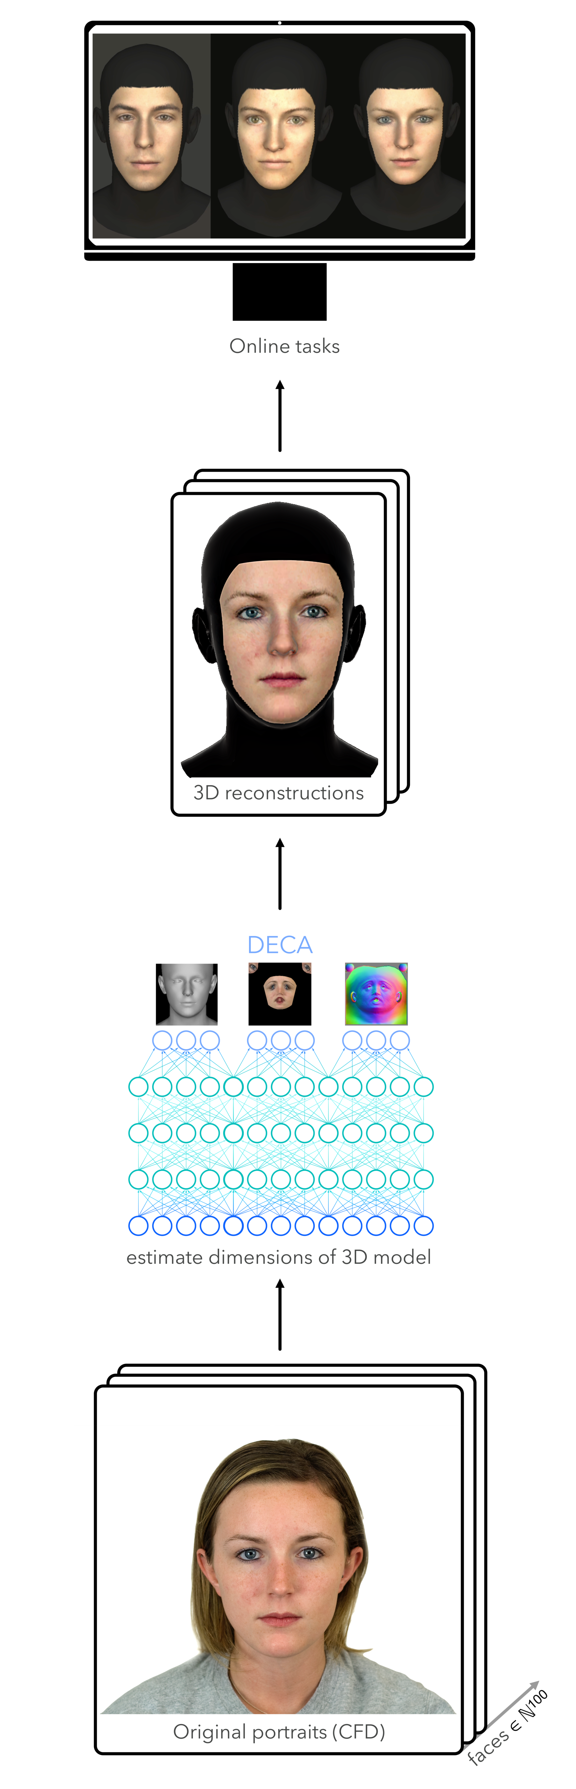
Data and Network:
Stimulus images were computed using the 3D reconstruction model DECA¹ applied to 2D portraits of the Chicago Face Dataset²
Human online experiment
1,397 participants were asked to judge similarities between 100 generated faces in a triplet-odd one-out task
Feng et al., 2021
Ma et al., 2015

Slide 22
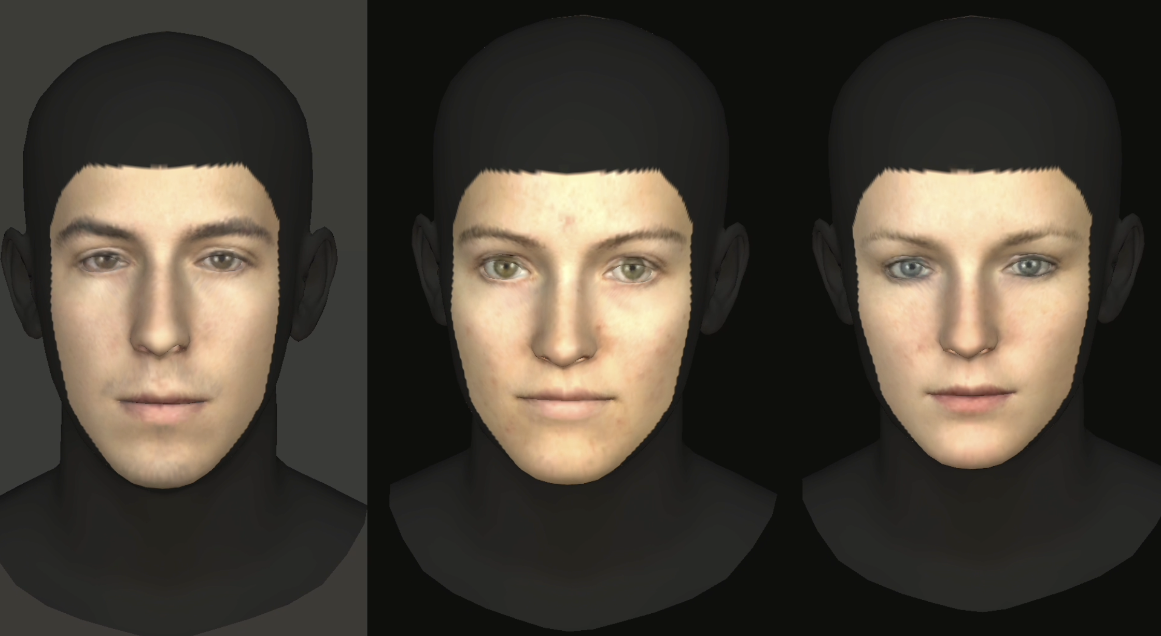
Data and Network:
Stimulus images were computed using the 3D reconstruction model DECA¹ applied to 2D portraits of the Chicago Face Dataset²
Human online experiment:
1,397 participants were asked to judge similarities between 100 generated faces in a triplet-odd one-out task
In two viewing conditions, 2D and 3D
Feng et al., 2021
Ma et al., 2015

Slide 23
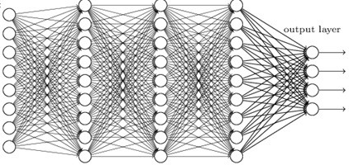
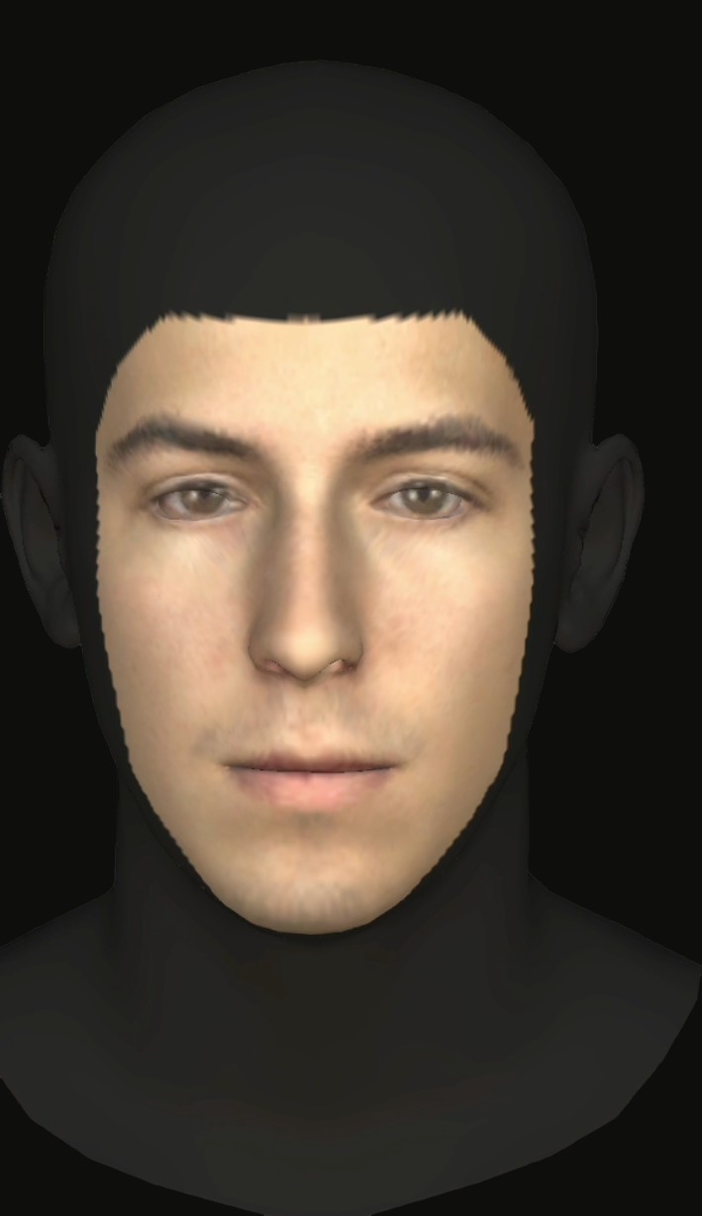
Data and Network:
Human behavior was modeled using a custom adaptation of VGG-Face¹
It was trained to predict human choices given sets of three face images (Aligned VGG-Face)²
For human similarity judgment of both 2D and 3D images.
Feed to the adapted model
Take 3 images of a trial
Predict human choices
VGG Face
Upper layers replaced by a new decision module
Lower layers frozen (up to FC7)
Parkhi et al., 2015
Hofmann et al., 2024

Slide 24
Data and Network:
Human behavior was modeled using a custom adaptation of VGG-Face¹
It was trained to predict human choices given sets of three face images (Aligned VGG-Face)²
For human similarity judgment of both 2D and 3D images
Rebuild pre-trained VGG Face
lower layers frozen :: up to FC_7
VGG bridge
upper layers replaced by decision block
input :: 3 face images of a trial
predict human odd-one-out choices
Parkhi et al., 2015
Hofmann et al., 2024

Slide 25
Data and Network:
Comparing similarity between representational spaces:
Human responses (Human Judgment)
2D viewing condition
3D viewing condition
The activation pattern of Aligned VGG-Face
2D viewing condition
3D viewing condition
The activation pattern of VGG-Face

Slide 26
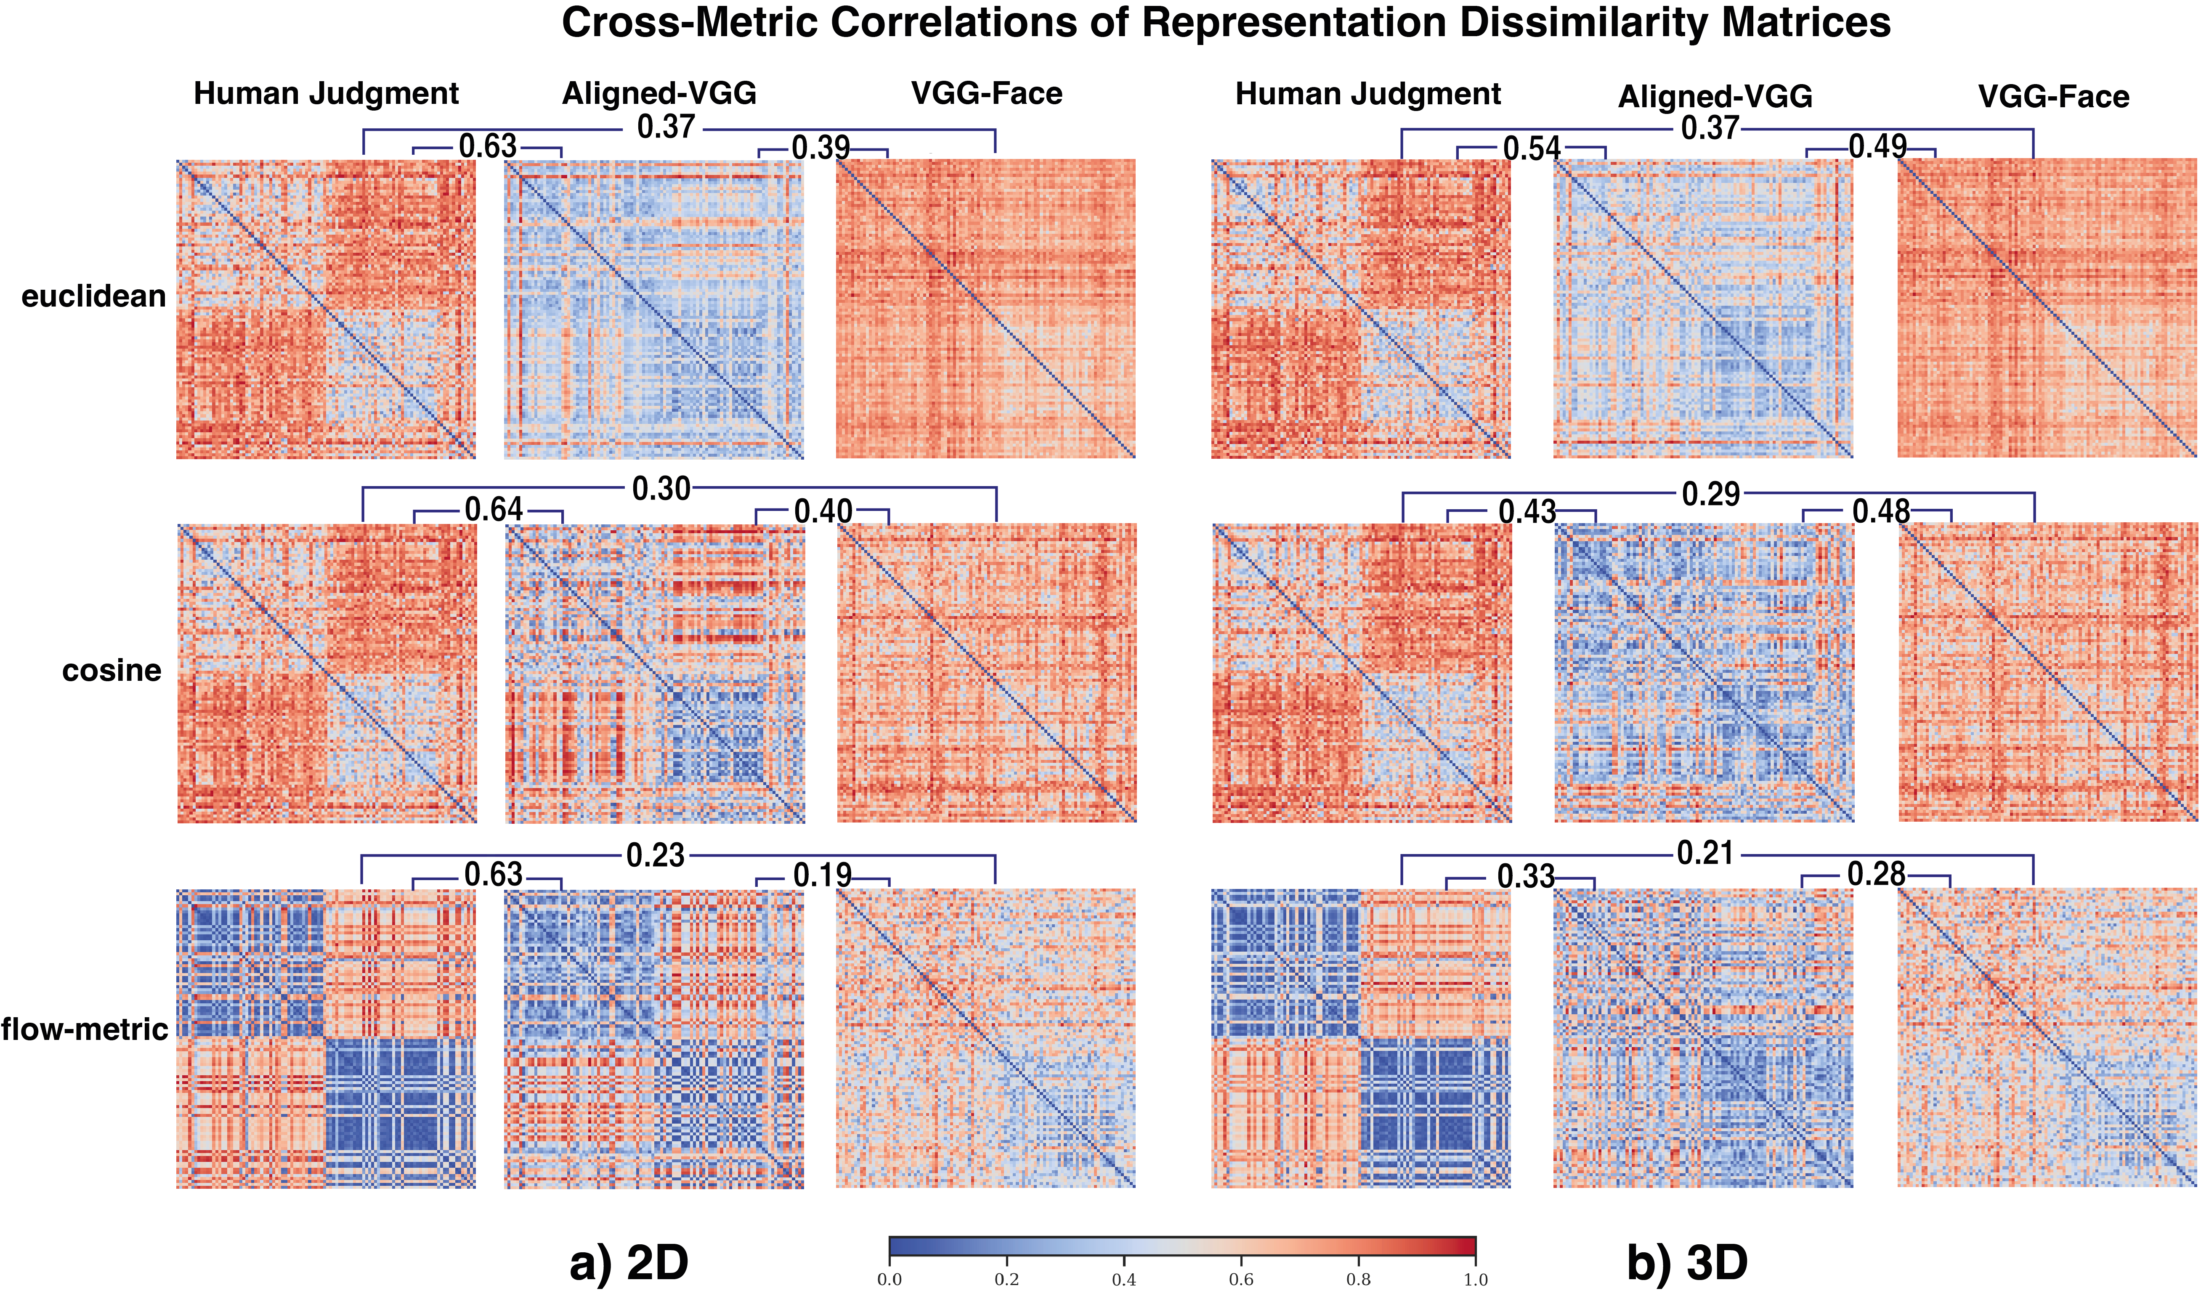
Results:
Focusing on three metrics: Euclidean, cosine, and Flow-metric.
Correlation of RDM matrices.
Comparison between 2D and 3D conditions.

Slide 27
Results:
2D condition :
Human Judgment and Aligned-VGG RDMs show a block-diagonal structure using the flow-metric.
Indicates a shared geometric organization by gender.
Demonstrates that behavioral alignment can induce human-like representational geometry under the matched condition.

Slide 28
Results:
3D condition :
Alignment fails to generalize when the network is trained on 3D behavioral data.
Traditional metrics (Euclidean r = 0.54; Cosine r = 0.43) overlook this change, while the flow-metric correlation drops to 0.33.
The network no longer preserves the distinct female face cluster (the first 50 images), which is clearly separated in human perception.

Slide 29
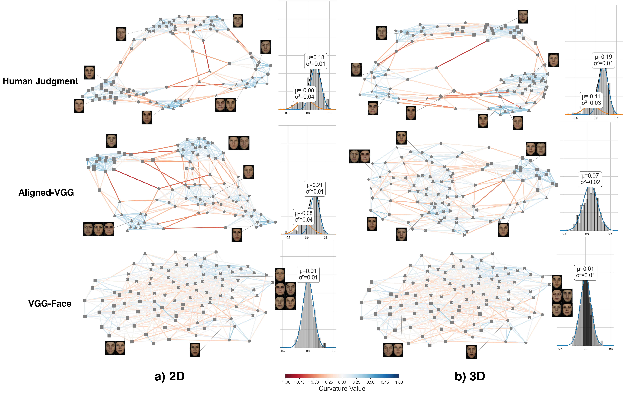
Results:
Communities (different symbols) detected by Ricci flow in 2D and 3D viewing conditions.
The Gaussian Mixture Model (GMM) component values of the curvature distributions are also shown in the distribution of curvature values.
Results confirm stronger 2D alignment and reduced alignment in 3D.

Slide 30
Results:
2D condition:
Human Judgment and Aligned-VGG show similar clustering patterns.
Both representations clearly group the face images according to gender.
Baseline VGG-Face shows no clear structure.

Slide 31
Results:
3D condition :
The structured pattern is less pronounced.
Human Judgment community structure changes (e.g., different number of clusters).
Aligned-VGG fails to reflect these changes, instead resembling the baseline VGG Face.
Quantitative community metrics support this observation.

Slide 32
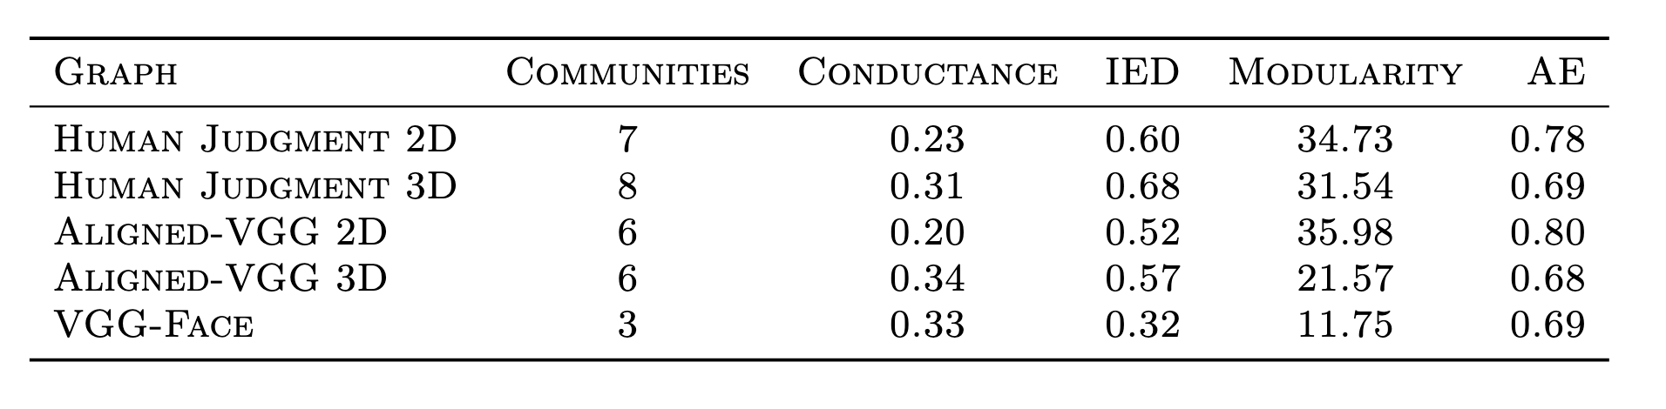
Results:
In the 3D condition, contrasting with the 2D, the geometry of the Aligned-VGG model does not
show human-like complexity and remains closer to the baseline VGG-Face.
Conductance: community separation by the between-and-within-edge ratio
Internal edge density (IED): edges within the community vs. the maximum possible
Average embeddedness (AE): number of shared neighbors for pairs of nodes within a community
Modularity: community strength by comparing edge densities with a random graph

Slide 33
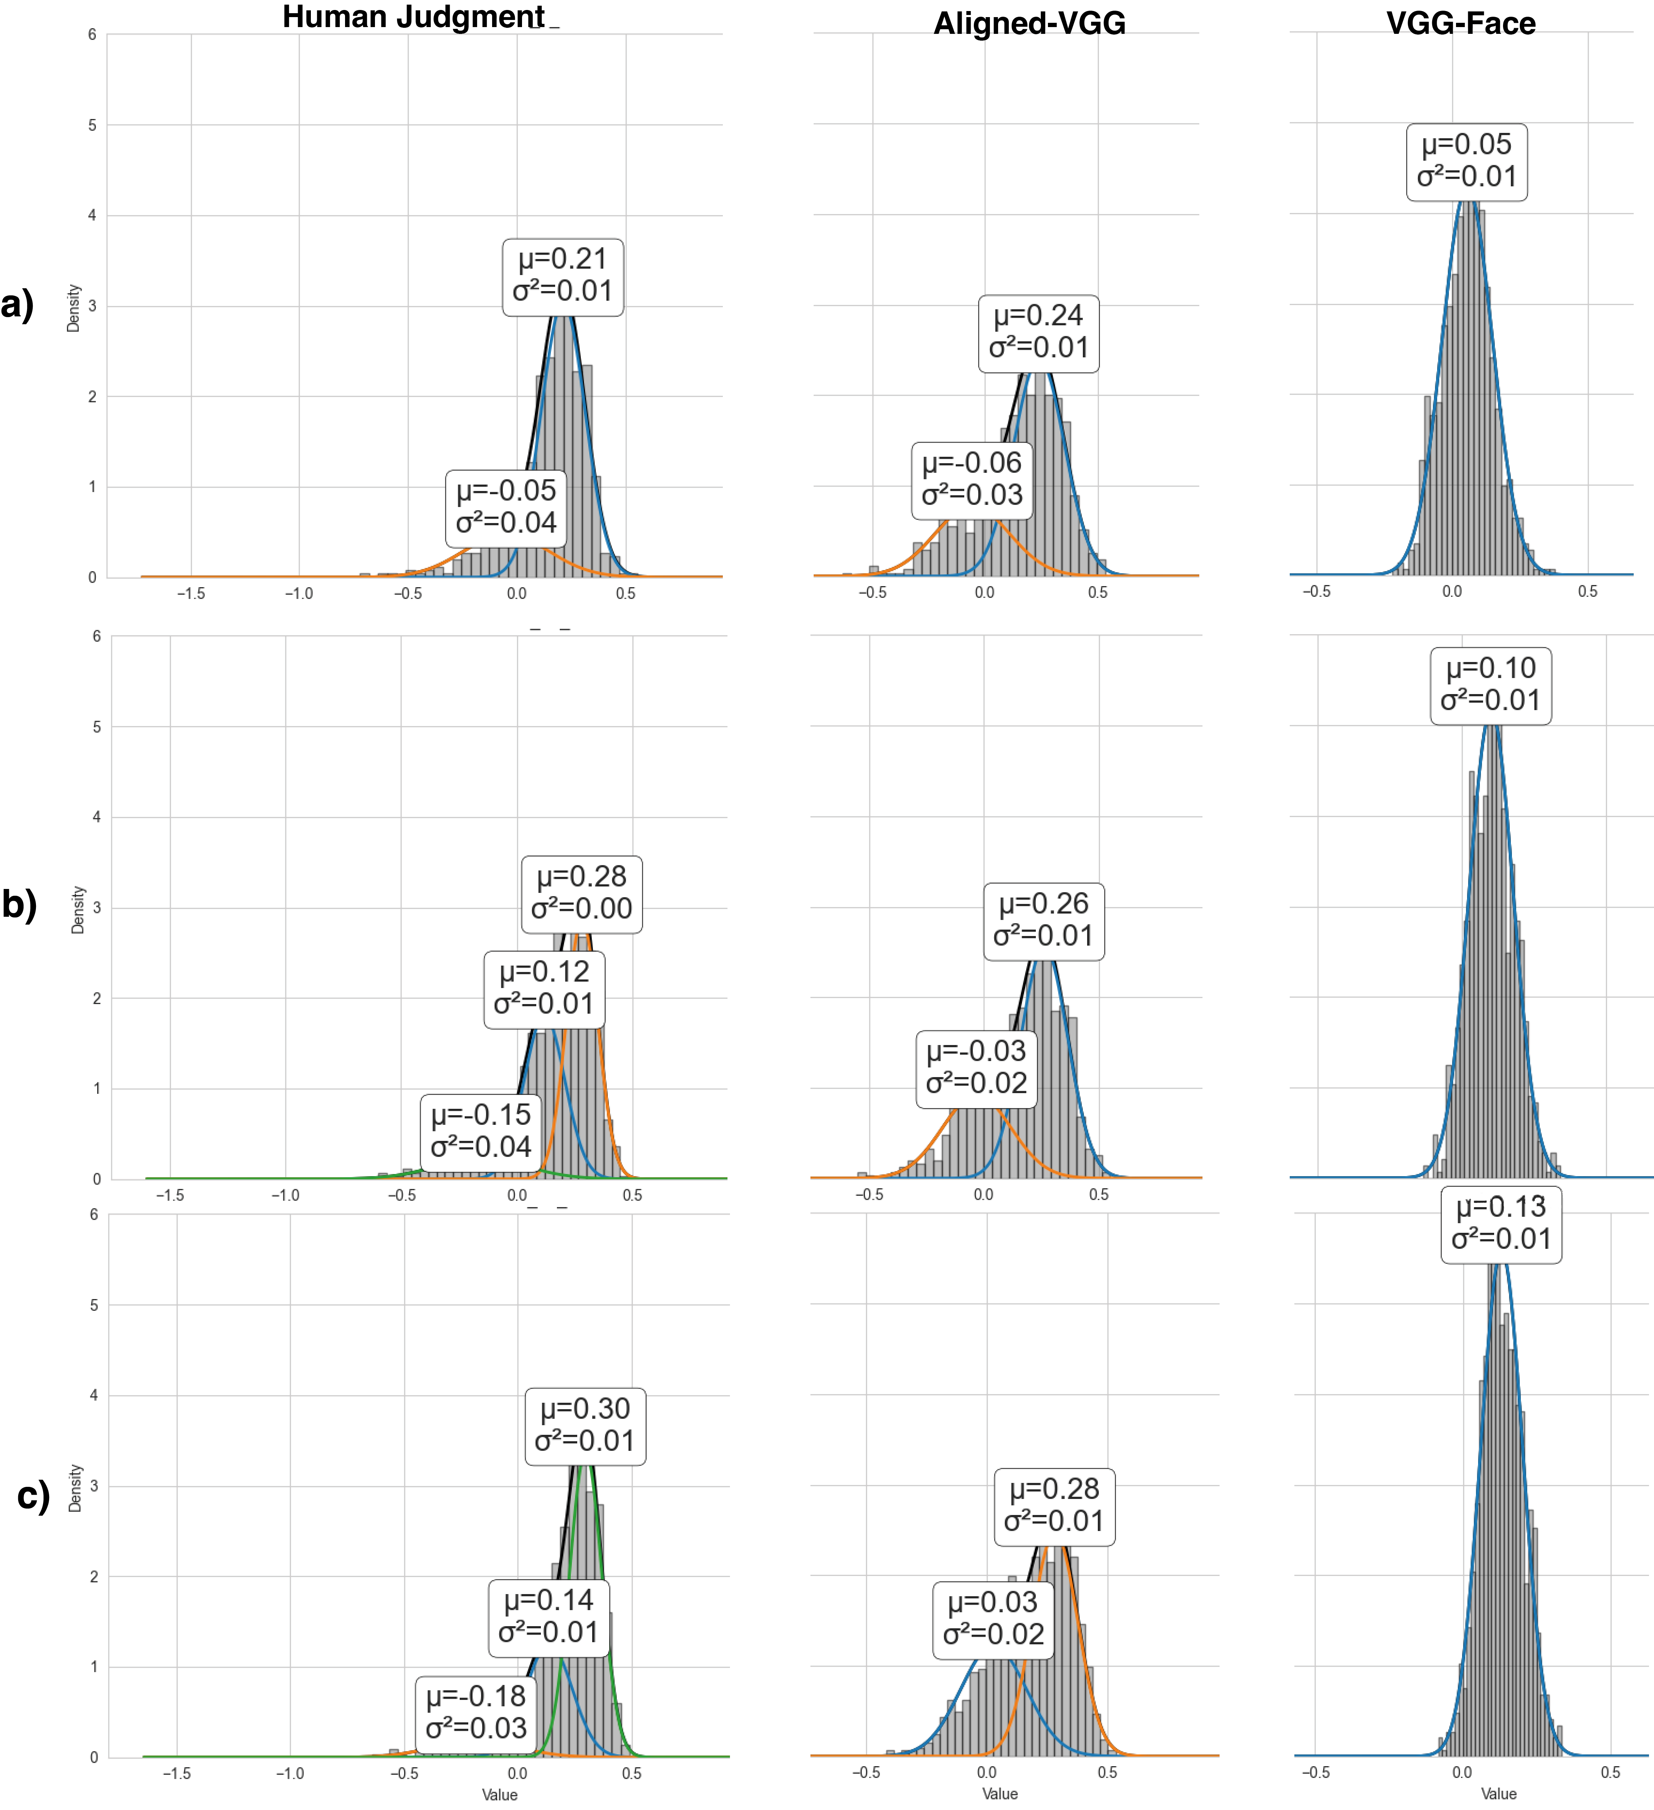
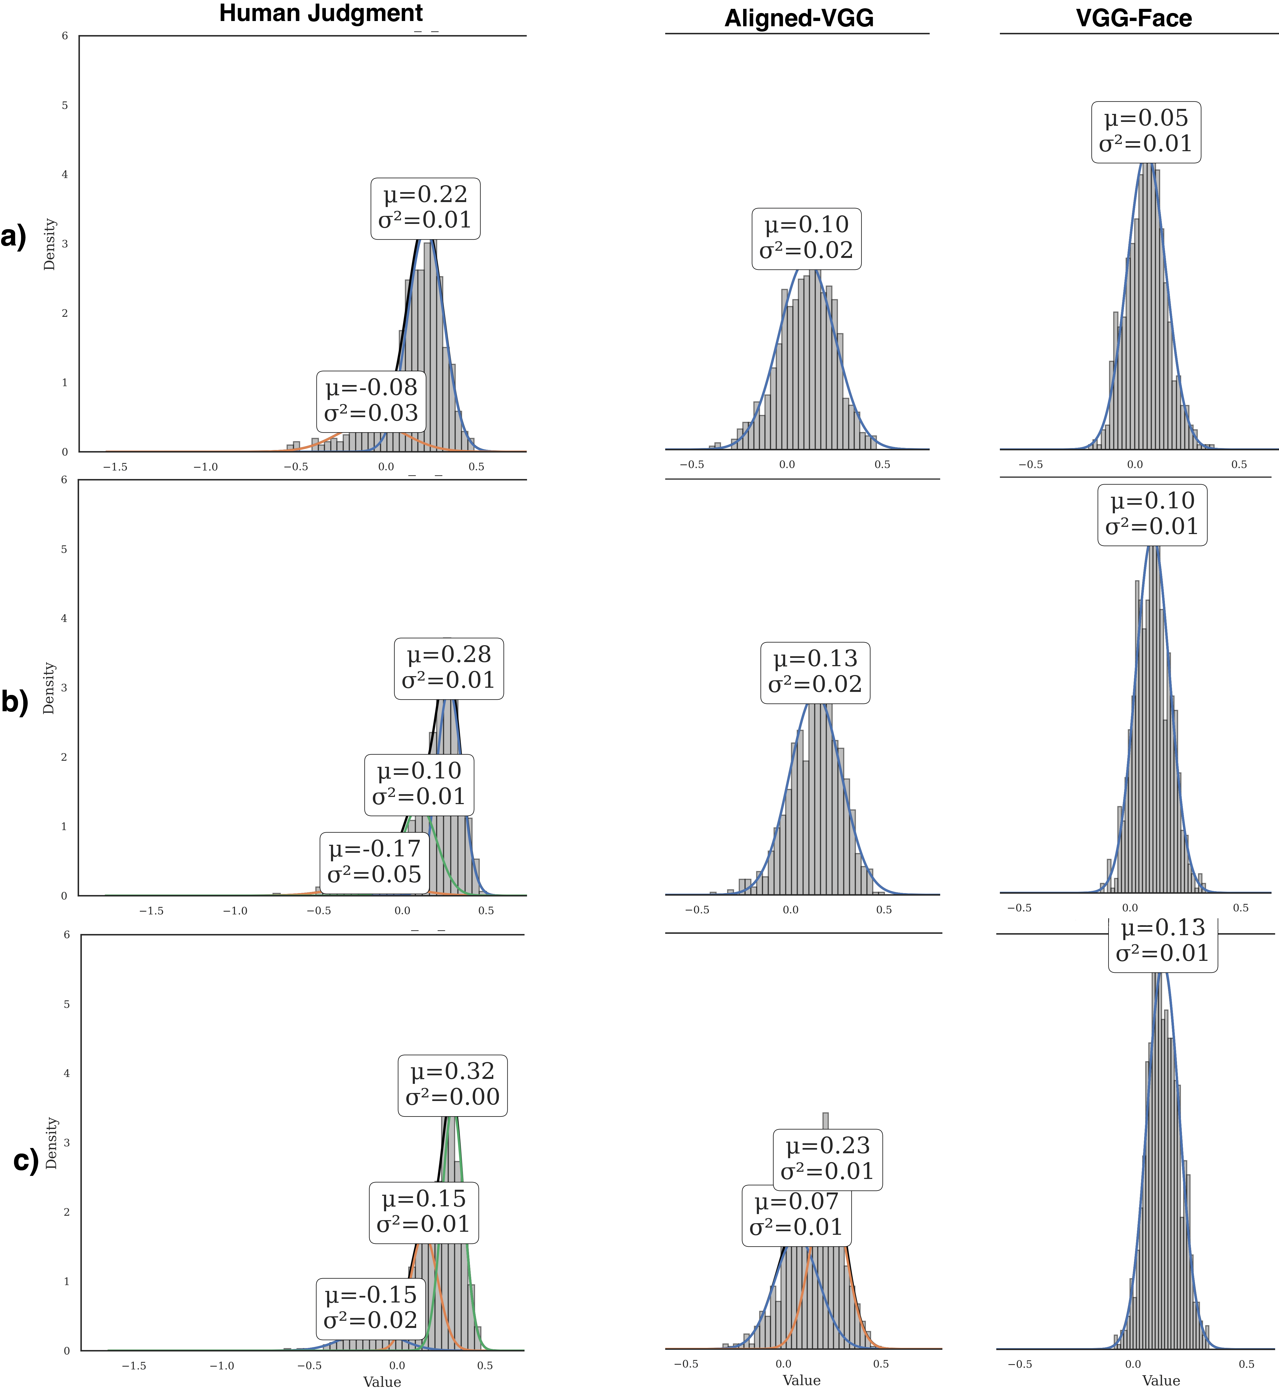
Results:
In the 3D condition, contrasting with the 2D, the geometry of the Aligned-VGG model does not
show human-like complexity and remains closer to the baseline VGG-Face.
2D
3D

Slide 34
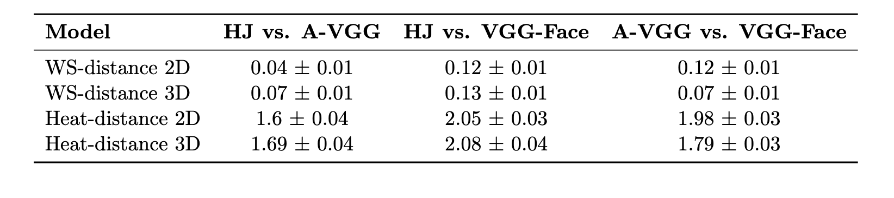
Results:
In the 3D condition, contrasting with the 2D, the geometry of the Aligned-VGG model does not
show human-like complexity and remains statistically closer to the baseline VGG-Face
Measuring the distance between curvature distribution using Wasserstein Distance (WS)

Slide 35
Summary:
Introduces a geometry-aware framework using curvature to capture local geometric information in representational alignment.
Shows that traditional metrics miss key geometric discrepancies, revealing limits of behavioral alignment, high task performance ≠ human-like organization.
Reveals the model’s failure to form coherent semantic structures (e.g., for female faces in 3D).
Indicates that behavioral feedback in 3D imposes weaker geometric constraints than in 2D.
Concludes that effective alignment requires model representational capacity (e.g., 3D processing) to match the complexity of human perception.

Slide 36
Any Questions?!

Slide 37


Thank you for your attention!
Please reach out to us!
torbati@cbs.mpg.de

